Slide 1
USAA P&C Chatbot (POC & POT) presented by : Arghadeep Chaudhury IBM Confidential

Slide 2

Problem Statement
CWH Tracker, Policy System of Record, Claims System of Record, Common data elements tracker, Wiki, BOX, Shared Location etc. Scrum Master, Team Lead, DPO, SDAR Team, IT Team, GW Team, Person X, Person Y etc. I want the see the details for Loss amount, how do I find that details? I don't have access to CWH tracker, how to find some information from that file? I know partial business attribute name ( i.e. FNOL) , where to find lineage information? Can I get a lineage information in excel format for particular data elements? Based on Legacy Data Mart column name how do I get Information Model details? I am doing physical data model how do I get the Information Model details? Can I find Info model details based on CWH column name? Where should I get the Claims Mapping document? How to find legacy transformation logic for Total Loss amount? I am from Policy team how I get some lineage information for one common data elements? When it comes to data related queries ( i.e. source info, target info, data lineage, mapping etc.) from employees they are lost with so much scattered information, and which leads to frustration of not getting right advise/information. In the last few years there are significant changes in terms of process, guidelines and tools/tech. associated with them. Many People not aware of all the process or recent changes hence unable to provide right guidance/information to practitioners. People's role and program didn't success due to misalignment or lack of knowledge.

Slide 3
Benefits and Opportunity
Presently P&C team needs to search business information's related to common topics across business domains involves time and manual efforts, as well as to address some common FAQ, The chatbot in increasing productivity of the work.
The bot will reduce the time by helping users to find right information and thus help to reduce efforts.
The bot is available 24/7 and can assist user with right information across geography and time zones.
Bot can support wide range of possible applications and con integrate all together from the single platform.
Chatbot can provide immediate feedback on the information.
Key Features
The chatbot can provide automatic response to the popular FAQ once bot gets train with the target dataset
The Bot application can help the data model team and cross domain team by providing unbiased interactive platform with correct set of information
The bot can generate runtime diagram and data lineage flow and support the download operation of required information.
The application is a closed box solution and have no impact on the present process
The application needs no vigilance and guidance.
Bot solution can be integrated to slack, standalone webpages and to any other USAA communication channels.
The application is self-learned and self trained from fallback and outliers powered by automation
It can support domain modeling for the target business subject areas with auto extraction of wiki information.

Slide 4
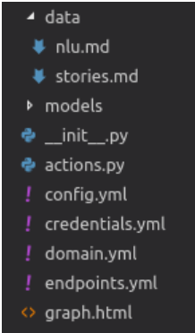

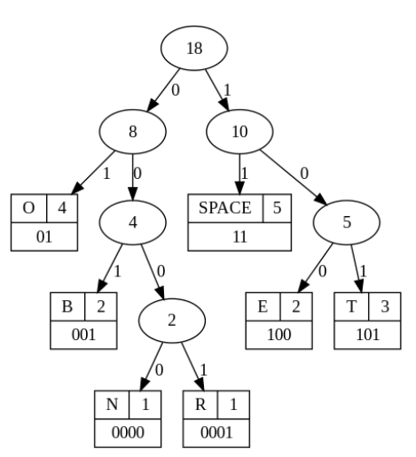


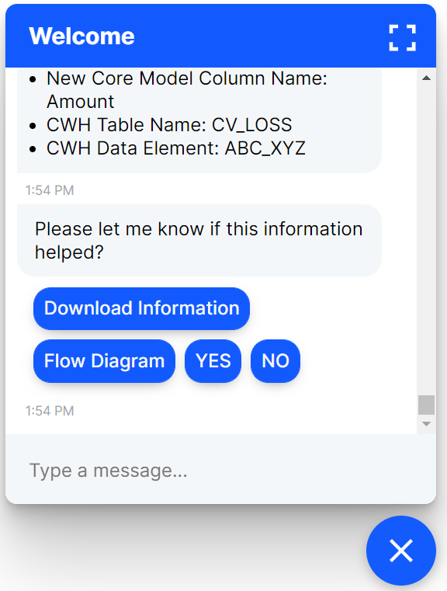
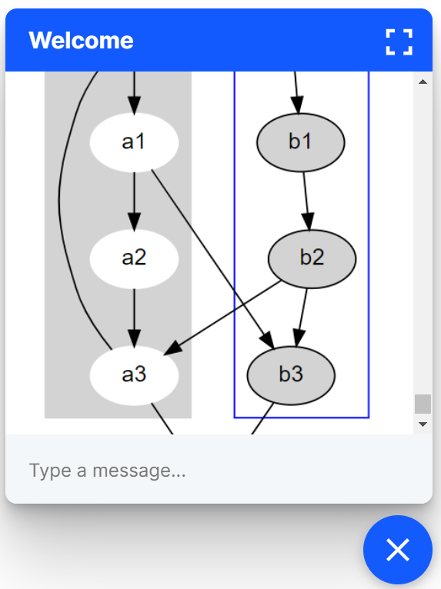


P&C Modernization Chatbot
config.yml
RDBMS
(Database)
Wiki Pages
nlu.yml
Training Data Extractor
(Automation process)
domain.yml
CWH Sheet
eralchemy
rule.yml
SOR Sheet
graphviz
story.yml
ML Engine
Change & Feedback
AI Model
Batch Training Program
Automation Detection Program
BOT USER

Slide 5
Bot Framework with : RASA
About RASA:
Rasa supplies conversational AI infrastructure for a global community of developers, providing the tools to build chat-based contextual assistants.
Rasa is powered by open source and machine learning framework for building AI assistants' software and runs in production across industries like healthcare, financial services, retail, and insurance.
Rasa support any programming language experience although custom operations need to write in Python.
Link : https://rasa.com/
Insurance industry with rasa example : AXA insurance
Packages needed for RASA to Onboard :
Rasa python library :https://pypi.org/project/rasa/ needs to be included in USAA python nexus repository.
Quick Installation Steps:
C:\> python3 -m venv ./venv
C:\> .\venv\Scripts\activate
pip3 install -U --user pip && pip3 install rasa
And We are now ready to go!
Additional library needed for this solution is – eralchemy with Graphviz installed for generating runtime diagrams and graphs.

Slide 6
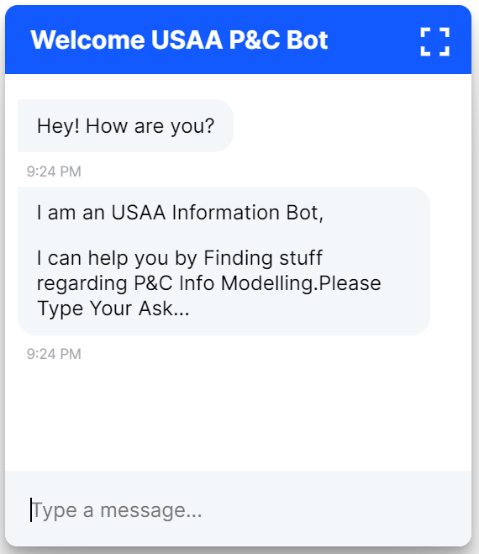
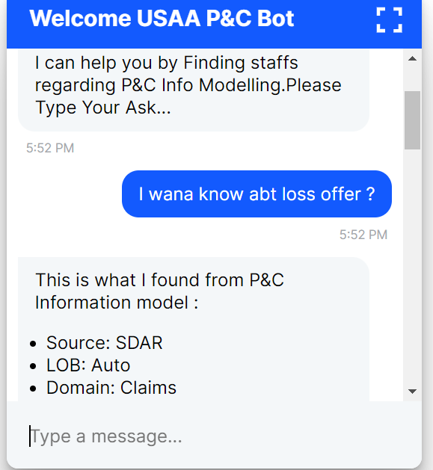
Screen Shots from DEMO
1
2

Slide 7
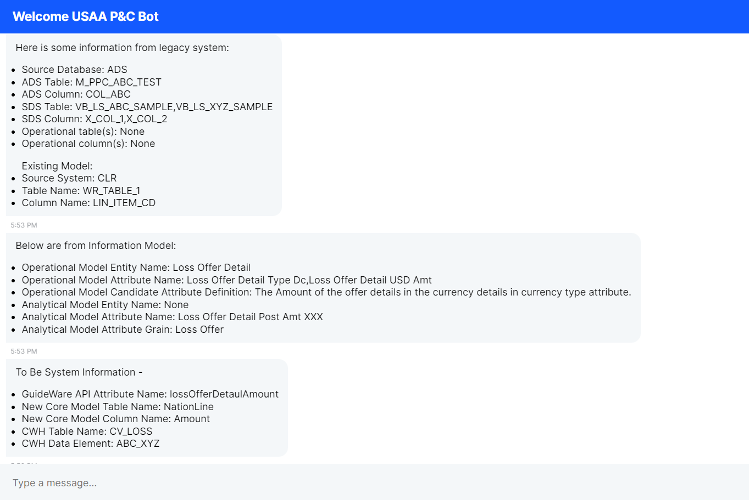
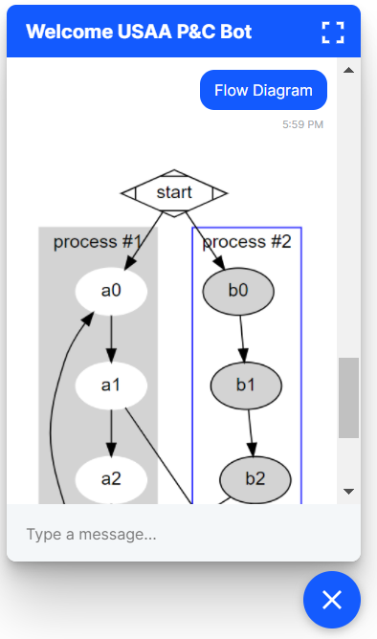
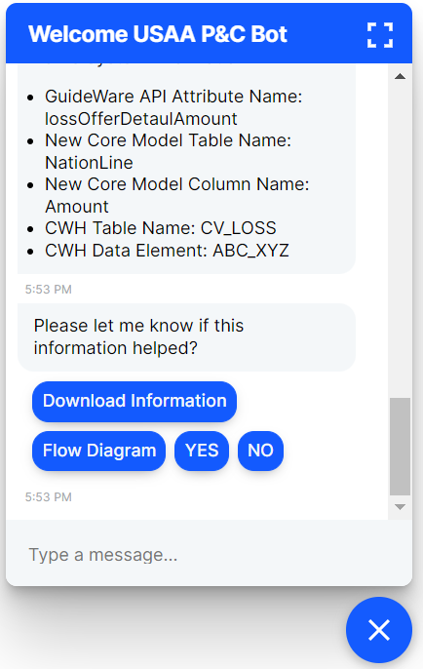
4
5
3

